Slide 1

Finalists Pitching Session 1
3 May, 09:00 AM EDT // 15:00 CEST

Slide 2
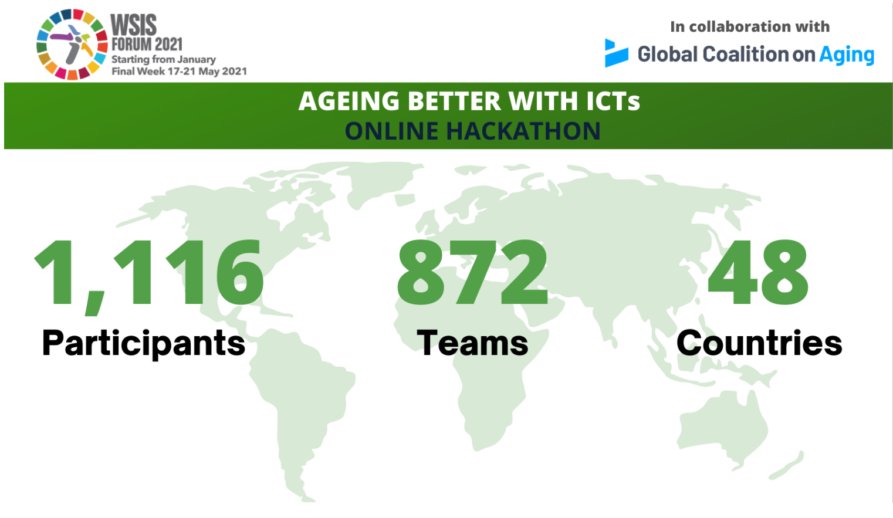

Slide 3
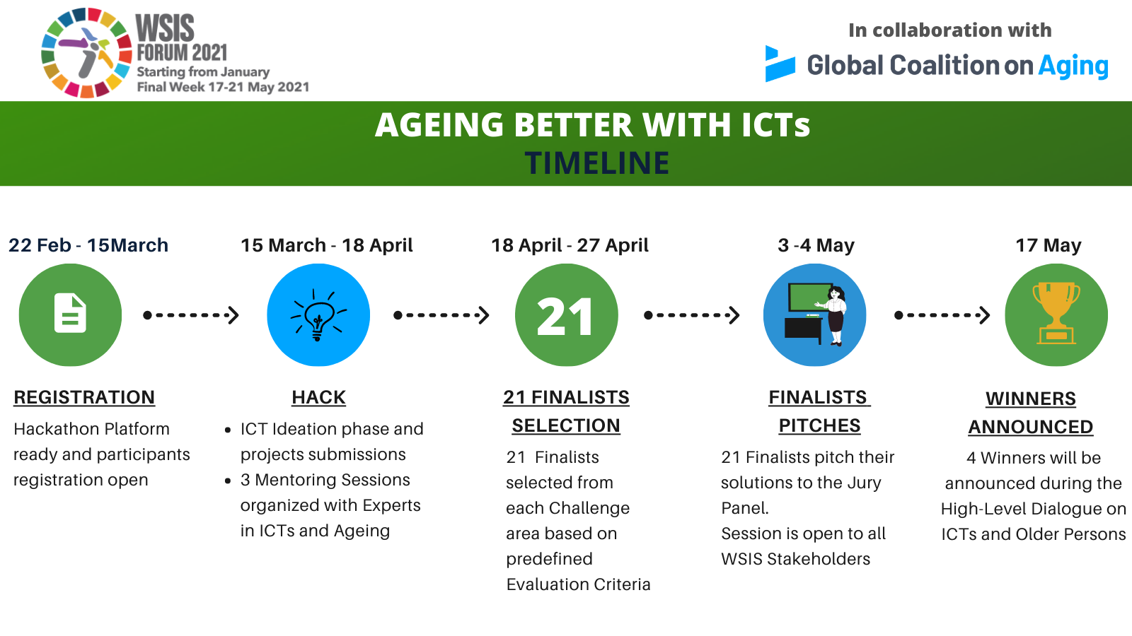


Slide 4

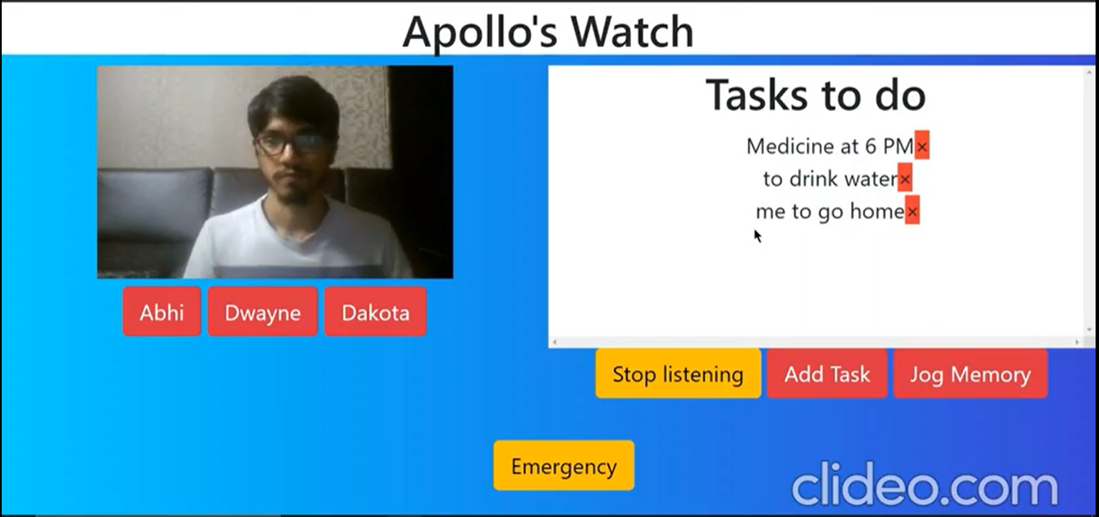
Project : Appolo’s Watch
1
INDIA
TEAM Name
Hephaestus
Team Age Group
21-22
CHALLENGE AREA
Alzheimer’s Disease and Cognitive Decline
The solution the team worked on is targeted towards people with Alzheimer’s disease in early stages, when the person is capable of responding to their surrounding environment.
Key Features:
•Voice Assistant: A voice assistant which periodically converses with the person to keep their brain active and jog their memory about their daily activities.
•Computer Vision: The voice assistant uses a video feed of what person sees in order to instruct them as to who or what they looking at, or where they should go in their house.
•Health Monitoring: The person’s vital signs like blood pressure, heart rate etc. can be continuously monitored remotely by their family members.

Slide 5
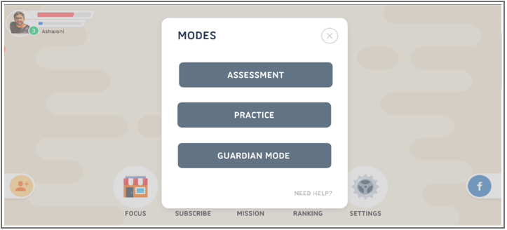
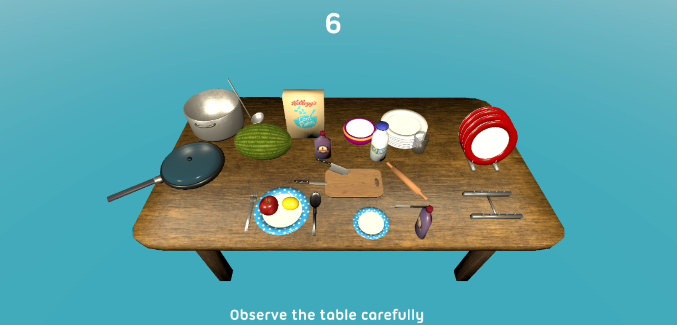
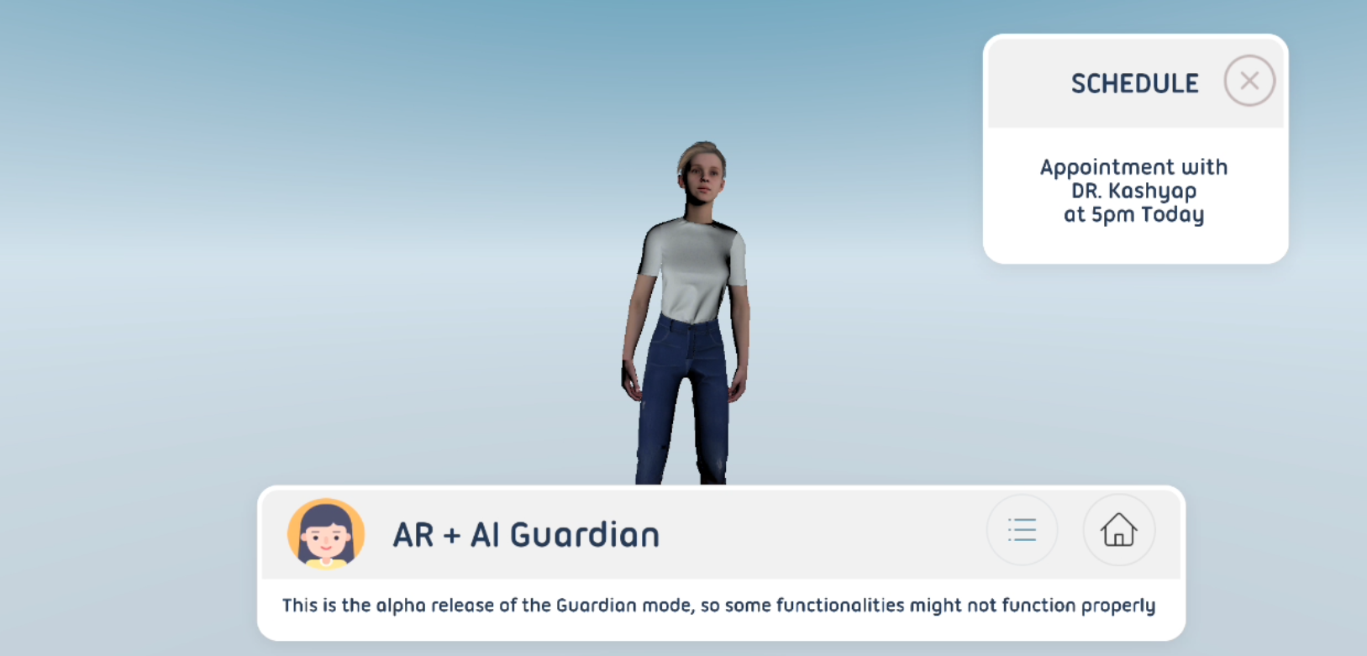
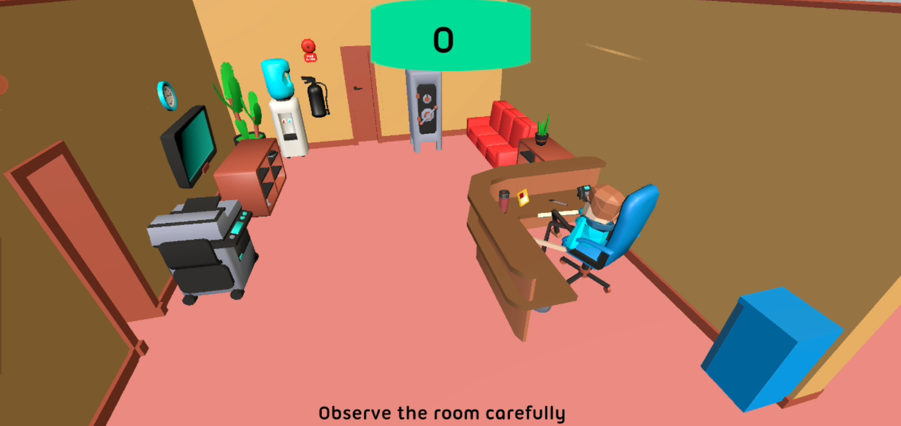
Project : Dementi-AR
2
INDIA
TEAM Name
AugVirtz
Team Age Group
21-22
CHALLENGE AREA
Alzheimer’s Disease and Cognitive Decline
The team has identified 3 major points to work on when it comes to Alzheimer’s disease and dementia:
Early Assessments: one of the major issues is detecting Alzheimer’s in the early stage so that intervention can occur severe impact can be avoided.
Practice: if Alzheimer’s or dementia is identified, we would need to train one’s Spatial and Facial Perception, which gets disrupted in the patient
Guardian: constant guardian support is something that is a must for the patients. We would also need a database, to look after the movements and activities of the patient.

Slide 6

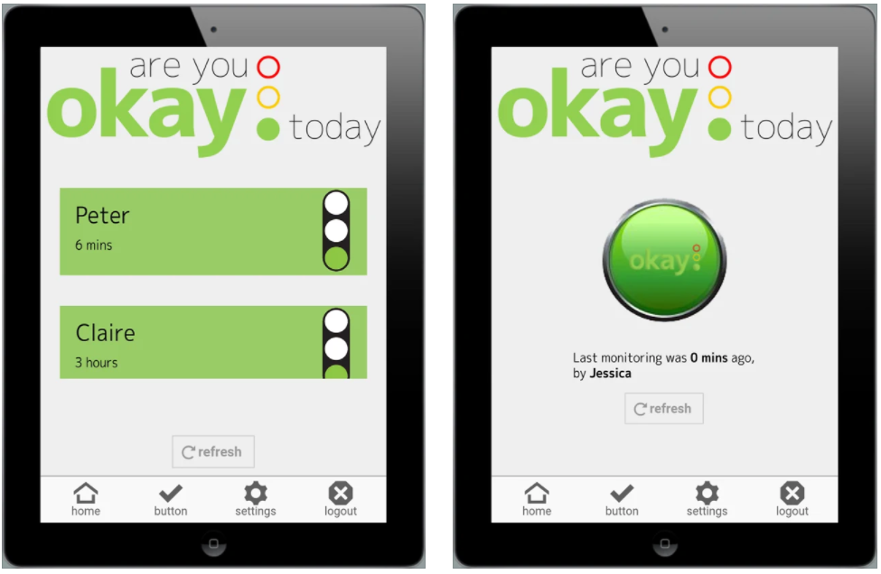
Project : Early detection of Alzheimer's disease
3
NETHERLANDS
TEAM Name
AugVirtz
Team Age Group
48-83
CHALLENGE AREA
Alzheimer’s Disease and Cognitive Decline
1 - Invented an unique technical concept for an early detection of the Alzheimer's disease by collecting the daily behavior of the usage of electricity, gas and water for many years
2 - Defined and solved two major problems :
What behavioural changes are relevant and can be measured with technology? → The pattern of behaviour of the daily use of electricity, gas and water
It is very difficult to find healthy vital elderly that are willing to participate for many years with issues such as motivation, privacy impact, data security and other issue → The users of "Are you okay today"
Notes:
The online hackathon will ideate ICT solutions that respond to challenges faced by older persons under 4 areas, that may have surfaced or emphasized by the COVID-19 pandemic. Participating teams will submit ideas and develop proof of concept in one of four identified challenge areas:

Slide 7

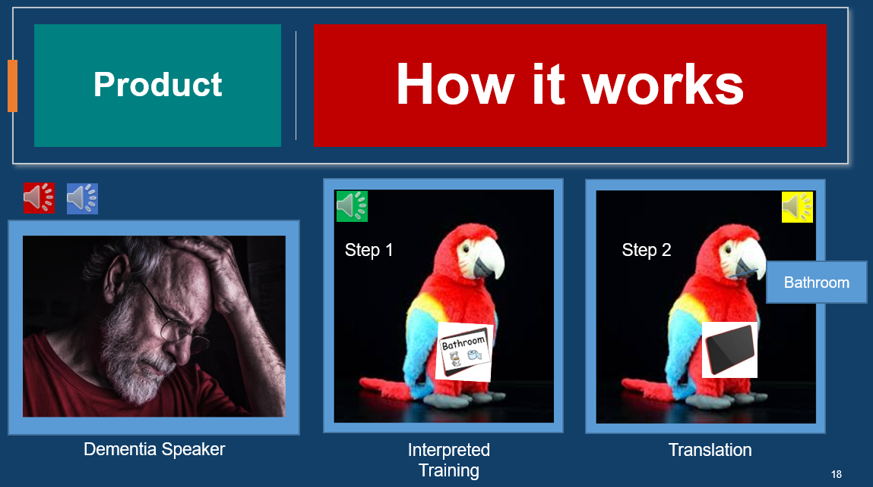
Project : Kin-Keepers.com, A voice translator for Alzheimer's sufferers
4
USA
TEAM Name
Kin-Keepers.com
Team Age Group
30-68
CHALLENGE AREA
Alzheimer’s Disease and Cognitive Decline
A Smart Parrot that listens and speaks to the elder, bringing feedback and certainty. The Smart Parrot not only aids the senior but becomes the eyes and ears for the family. Kin-Keepers’ proprietary technology offers reliable feedback for the 50 million suffering from dementia around the world; improving their lives and helping those affected live more harmoniously with families and carers
Notes:
The online hackathon will ideate ICT solutions that respond to challenges faced by older persons under 4 areas, that may have surfaced or emphasized by the COVID-19 pandemic. Participating teams will submit ideas and develop proof of concept in one of four identified challenge areas:

Slide 8

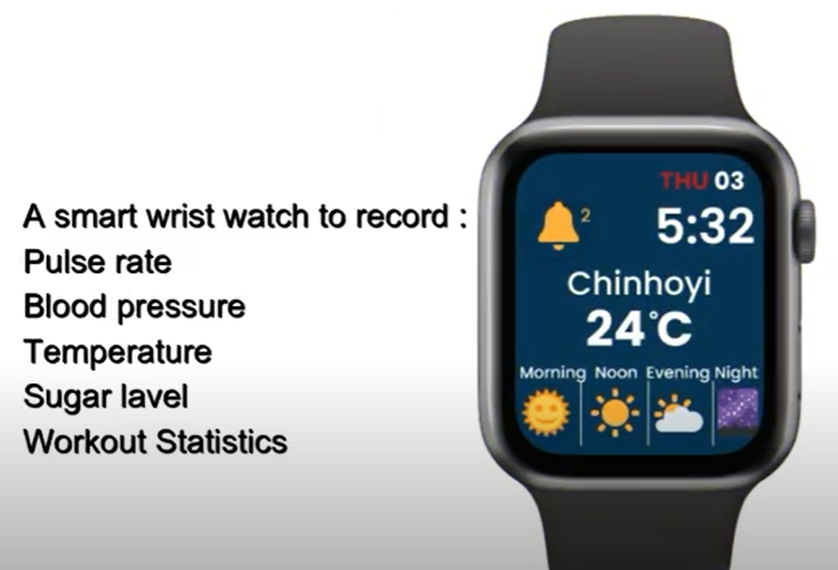
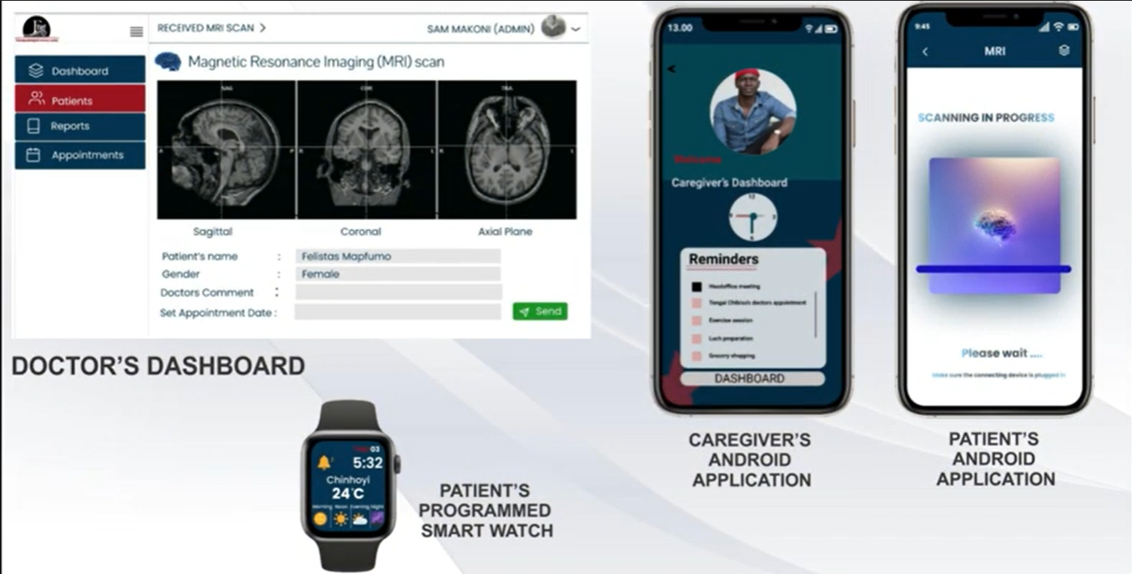
Project : HACK FOR CUT - FARI
5
ZIMBABWE
TEAM Name
Hack for CUT
Team Age Group
N.A.
CHALLENGE AREA
Alzheimer’s Disease and Cognitive Decline
FARI is a four way artificial intelligent voice system applied to users with or without Alzheimer’s disease. The system can be used by individuals from the age of 30 years old to enable early detection, those with the disease to manage its progression.
1- Smart wrist watch. Monitors the patient’s temperature, pulse rate, track patient’s location including calendar synchronisation which is a timer reminder received as alerts. The best part of the smart watch is its recording of blood pressure levels by measuring systolic and diastolic pressure. Tracking of fitness statistics are recorded. All that is recorded by the smart watch is send over to the care giver’s smart phone. The doctor’s smart phone receives the information which he/she requires from patient.
2- Patients or applicant system on smart phone : provides a registration platform, numerous games, music, virtual shopping, Q and A segment on a chat bot and images which include family member’s images.
3- Care giver’s system : contains doctor’s contacts, patients records which receives all the notifications from the smart watch, Q and A segment chat bot, care giver’s schedule, patience handler (eating, sleeping, behaviour (moody, talkative, absent minded, outbursts)) and a list of lipoproteins food.
4- Doctor’s system contain the care givers contacts, the patient’s records, appointments and head scans imaging reports.
Notes:
The online hackathon will ideate ICT solutions that respond to challenges faced by older persons under 4 areas, that may have surfaced or emphasized by the COVID-19 pandemic. Participating teams will submit ideas and develop proof of concept in one of four identified challenge areas:

Slide 9
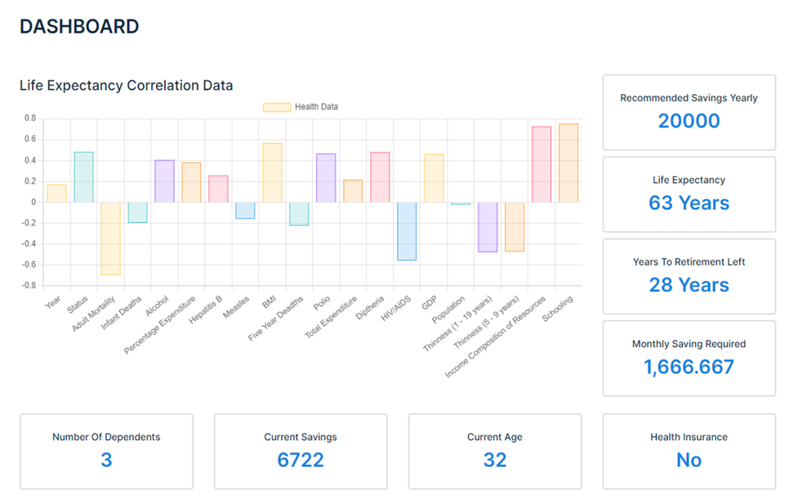
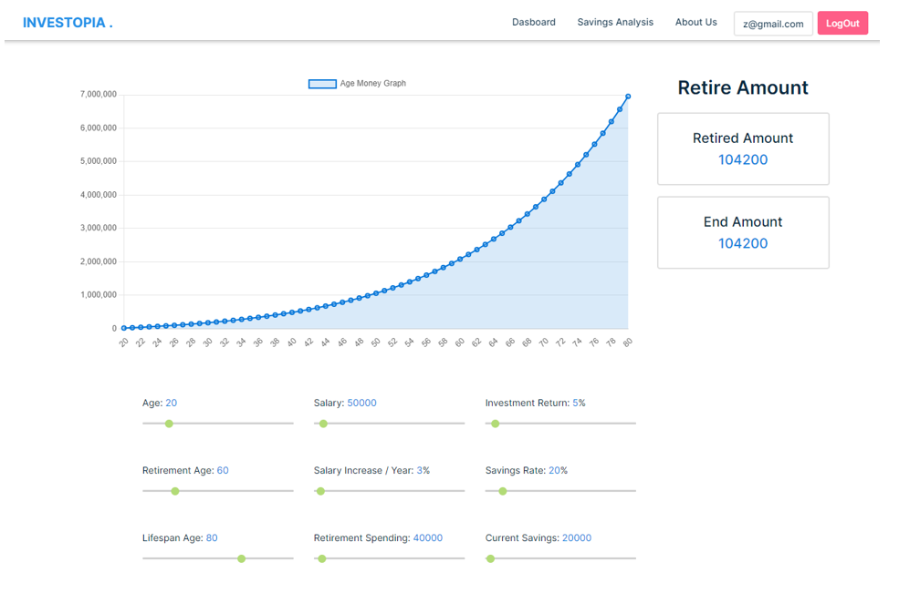
Project : INVESTOPIA
6
INDIA
TEAM Name
BASE 234
Team Age Group
24
CHALLENGE AREA
Financial Tools for Longevity
The team developed an Angular Web application that helps you to make better investment decisions based on your Data using Machine Learning, to divide your investment, and suggest you invest in various portfolios like Gold, Mutual funds, etc. to minimize loss and maximize profits. The goal is to make financial management easy from one place.
Notes:
The online hackathon will ideate ICT solutions that respond to challenges faced by older persons under 4 areas, that may have surfaced or emphasized by the COVID-19 pandemic. Participating teams will submit ideas and develop proof of concept in one of four identified challenge areas:

Slide 10
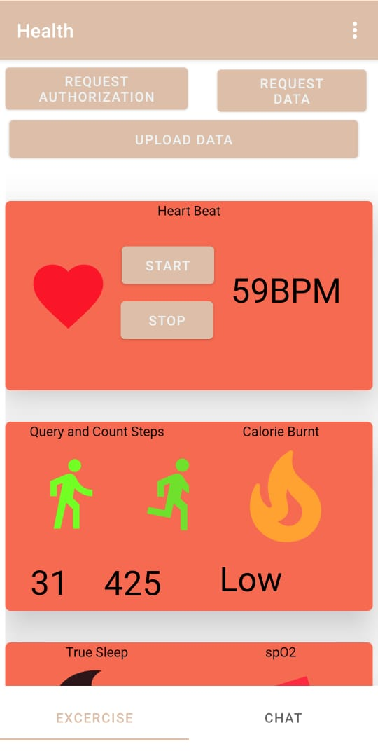
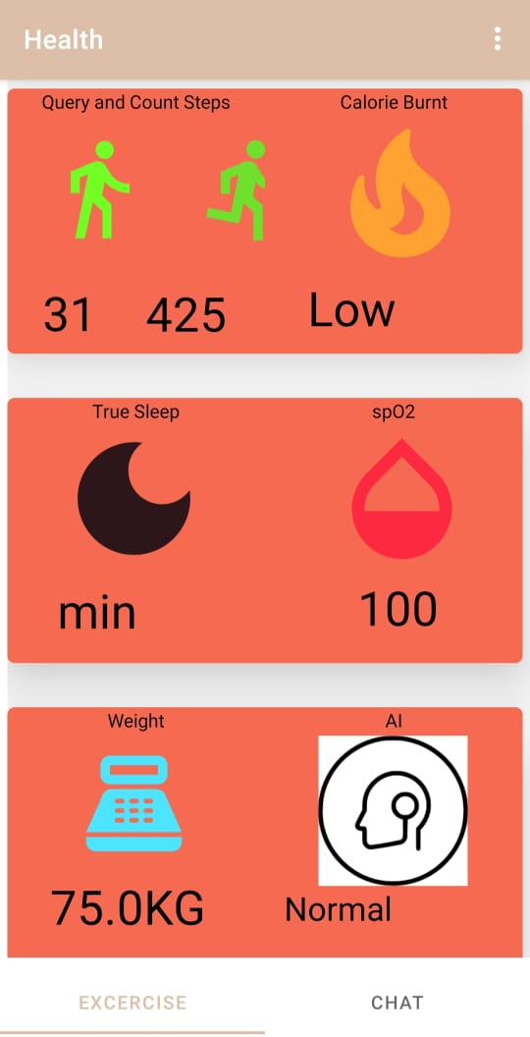
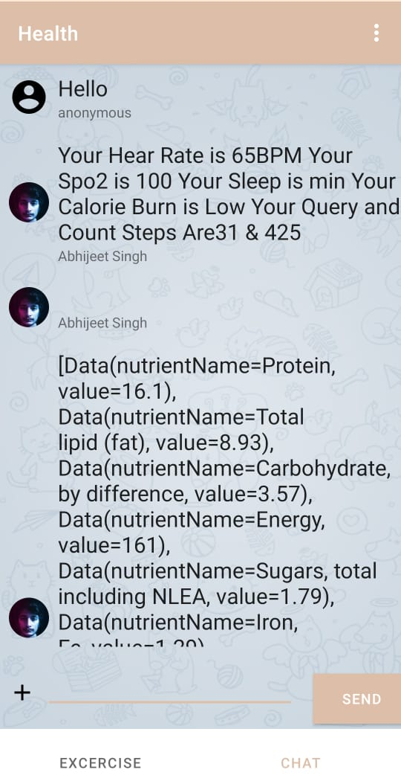
Project : Tracking User Health Data and Providing platform to share Health
Data with Healthcare Professional
7
INDIA
TEAM Name
Vayu
Team Age Group
20
CHALLENGE AREA
Frailty
Physical Activity and Good Nutrition is the solution to prevention of frailty, and our solution compromising these as our core points
The team developed an android application that tracks user health data through wrist bands, that provides a platform to share with healthcare professionals, and alerts the user if some health data is lower than a certain level. The app tracks H\heart rate, calories, Spo2, weight and sleep. An inbuilt Chat
Application is embedded to communicate with healthcare professionals easily. The user can check the details of nutrition in food, and a live heart rate monitors heart rate. There is a food calorie provider that provides the information of calorie in food, and sends an alert to the user if calorie is less than 383 cal and BMI is less than 18.5 (Frailty-defining criteria by Women’s Health and Aging Studies (WHAS) and Cardiovascular Health Study (CHS)).
Notes:
The online hackathon will ideate ICT solutions that respond to challenges faced by older persons under 4 areas, that may have surfaced or emphasized by the COVID-19 pandemic. Participating teams will submit ideas and develop proof of concept in one of four identified challenge areas:

Slide 11
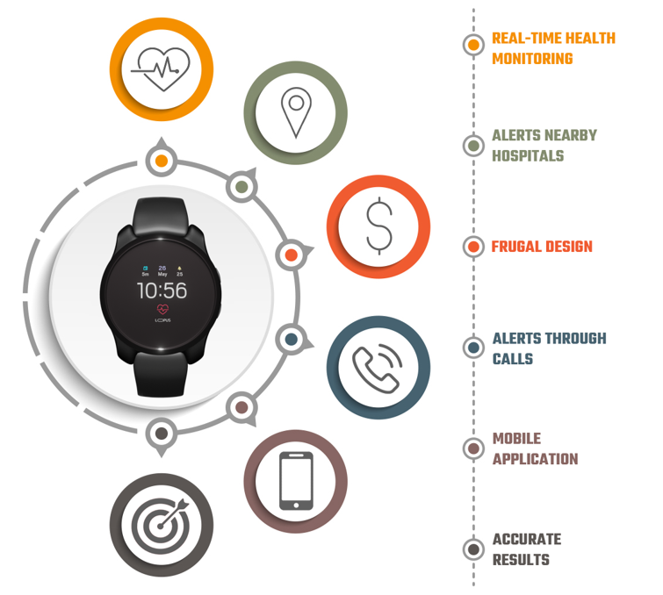
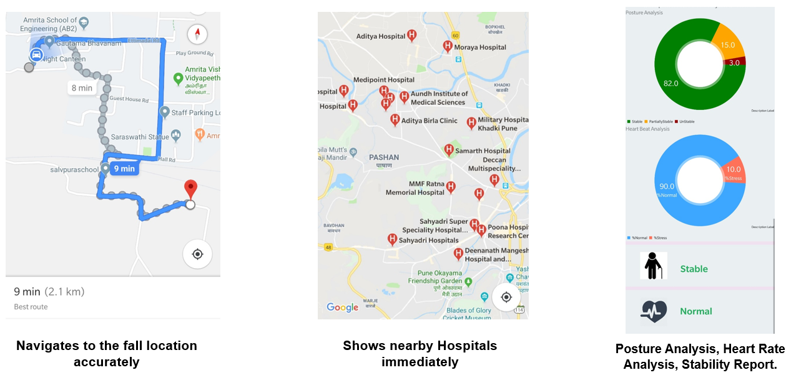
Project : Elderly Fall Detection and Remote Monitoring System along with
Indoor Localization
8
INDIA
TEAM Name
Team SAK
Team Age Group
22-37
CHALLENGE AREA
Frailty
The team developed an affordable IoT wearable product which can monitor their movement, health conditions and also detect their fall immediately. Also, the equipment alerts the caretaker by an auto-generated call. Detection is not done before the fall or when a person remains at rest, instead it detects the fall and alerts a caregiver immediately so he/she can take the necessary action to save the injured, well within the golden hours. The wearable band is designed with an Accelerometer Sensor and Gyro Sensor using which we have measured the rate of change of angle in respective sensors during various simulated falls and arrived at a threshold value for each of the sensors. Caretakers can also track the health parameters of elders such as the heartbeat, fall pattern, etc. using the mobile app which works in line with the wearable. Moreover, to detect falls even without wearable bands, a smart bathroom which is capable of detecting falls and send alerts when a fall occurs has been designed using IR.
Notes:
The online hackathon will ideate ICT solutions that respond to challenges faced by older persons under 4 areas, that may have surfaced or emphasized by the COVID-19 pandemic. Participating teams will submit ideas and develop proof of concept in one of four identified challenge areas:

Slide 12

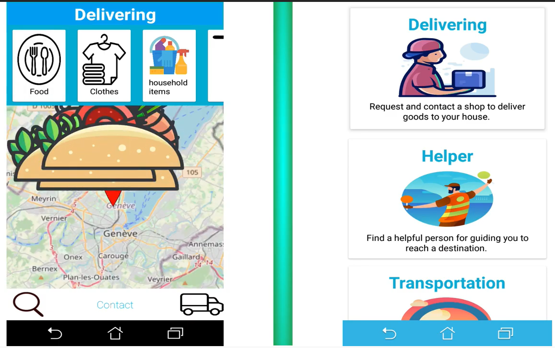
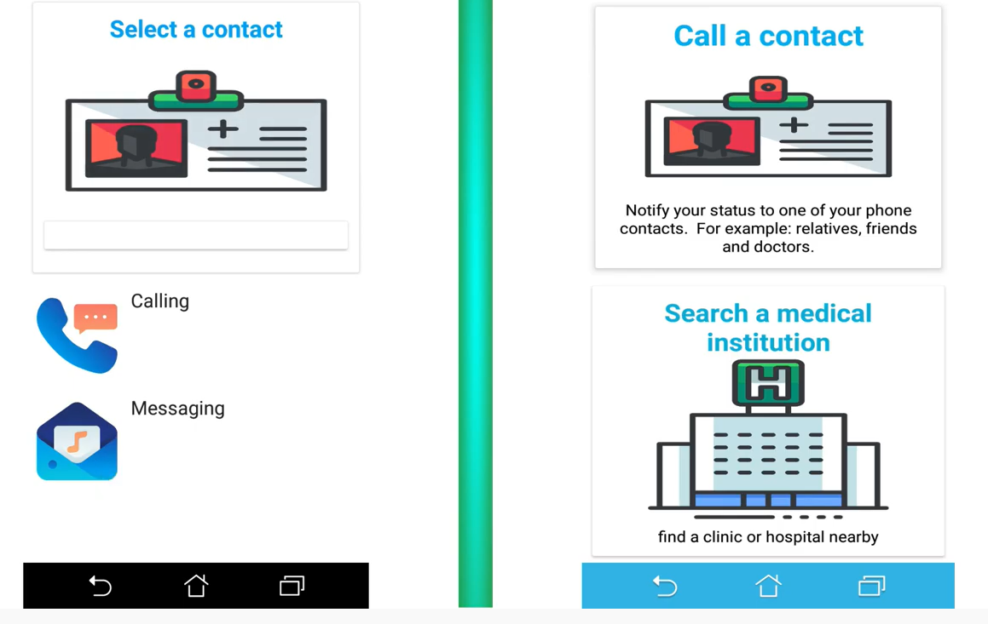
Project : KIT - The helping hand
9
GUATEMALA
TEAM Name
Carlos
Team Age Group
20-25
CHALLENGE AREA
Transportation and Mobility
The team has developed an application which encompasses:
a travelling support system
a location tracking support system through Google maps,
a medical support system,
a shopping and groceries assistance support system
a general support system where older people can ask for any other assistance like how to use a certain app etc.
The approach to give assistance to them will be very simple and impactful so that they will not feel neglected from society as they can work without help of family members
Notes:
The online hackathon will ideate ICT solutions that respond to challenges faced by older persons under 4 areas, that may have surfaced or emphasized by the COVID-19 pandemic. Participating teams will submit ideas and develop proof of concept in one of four identified challenge areas:

Slide 13
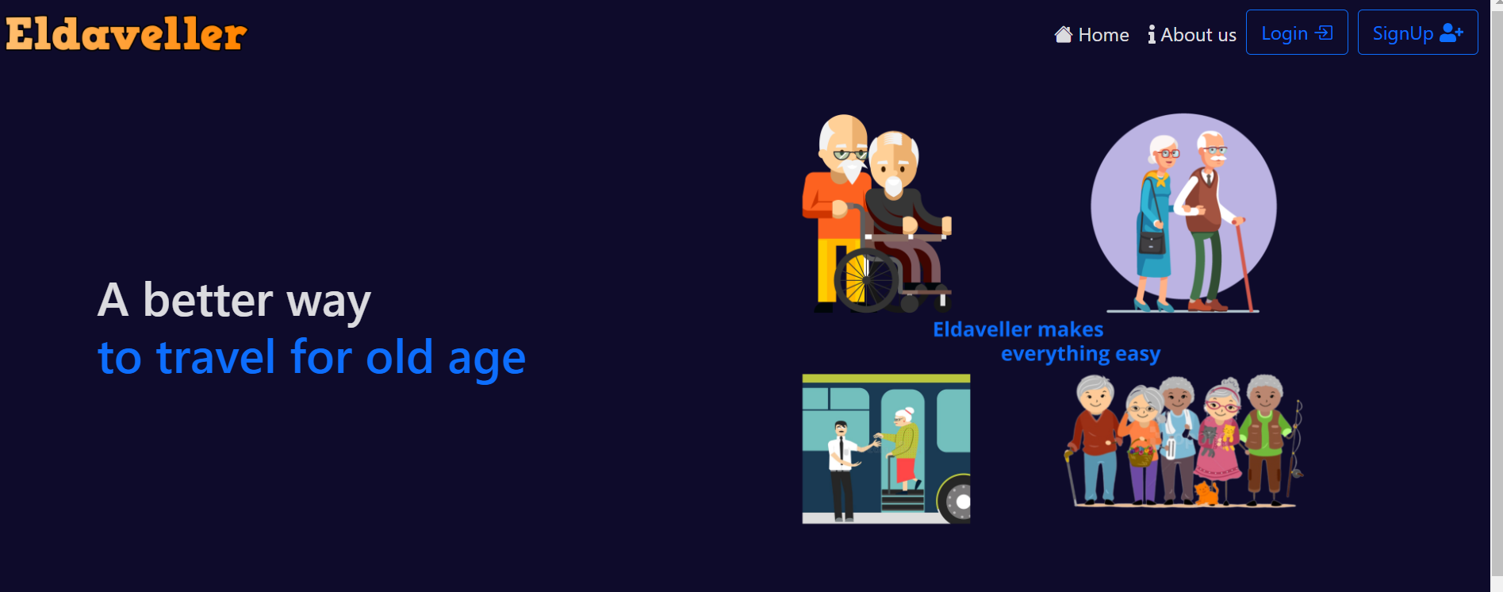
Project : ELDAVELLER
10
INDIA
TEAM Name
Sorcerers
Team Age Group
21-22
CHALLENGE AREA
Transportation and Mobility
The project titled ‘Travel Planner for visually impaired and limited mobility Community’ will help visually impaired and others with limited mobility to get easy access for transportation and mobility.
Various features like:
Planning of Journey,
Various nearby events,
Emergency Notification
Voice Assistance cater to specific needs.
Notes:
The online hackathon will ideate ICT solutions that respond to challenges faced by older persons under 4 areas, that may have surfaced or emphasized by the COVID-19 pandemic. Participating teams will submit ideas and develop proof of concept in one of four identified challenge areas:

